Slide 1


Lynn Haven, FL
Stormwater Fee Study
Commission Refresher
July 13, 2021

Slide 2

Agenda
Key Issues
Stormwater Fee Study
Benchmarking Survey
Stormwater Impact Fee Study
Timeline
Results

Slide 3
Key Issues and Proposed Solutions
Issue | Solution
Stormwater Fund is not self sustaining | Increase rate revenues to provide a sustainable level of funding by FY23
Annual support from Water & Sewer Fund | Phase out Water & Sewer Fund support by FY23
Large unfunded list of capital projects | Increase in-house resources Increase rates to fund projects Secure additional grants
No reserve for emergencies | Work up to a 3-month O&M reserve by FY24

Slide 4

Study Overview
Revenue Requirements
Fee Basis
Fee Structure
Results
  How much money is needed each year?
  How do we measure customer’s use of the system?
  How do we charge customers?
  What are the customer impacts?
  How are customers billed?

Slide 5
Revenue Requirements

Slide 6
Starting Point
Limited capital funding capacity
Majority funding is from the Water & Sewer Fund

Slide 7
Capital Improvement Projects
Description | FY 2021 | FY 2022 | FY 2023 | FY 2024 | FY 2025 | FY 2026 | FY 2027 | FY 2028 | FY 2029 | FY 2030 | FY 2031
Vac-Truck | $ 318,000 | $ - | $ - | $ - | $ - | $ - | $ - | $ - | $ - | $ - | $ -
Vermont Ave Drainage Improvements | $ 320,000 | $ - | $ - | $ - | $ - | $ - | $ - | $ - | $ - | $ - | $ -
Outfall Dredging | $ - | $ - | $ 175,000 | $ 175,000 | $ 175,000 | $ 250,000 | $ 250,000 | $ 250,000 | $ 250,000 | $ 250,000 | $ 250,000
Slip-Lining | $ - | $ - | $ 50,000 | $ 100,000 | $ 75,000 | $ 250,000 | $ 250,000 | $ 250,000 | $ 250,000 | $ 250,000 | $ 250,000
Driveway Culvert Replacement Program | $ - | $ 50,000 | $ 50,000 | $ 75,000 | $ 100,000 | $ 100,000 | $ 100,000 | $ 100,000 | $ 100,000 | $ 100,000 | $ 100,000
19Th & Montana Culvert & Ditch Replacement | $ - | $ 150,000 | $ - | $ - | $ - | $ - | $ - | $ - | $ - | $ - | $ -
Dundee Ln | $ - | $ 14,975 | $ 37,618 | $ - | $ - | $ - | $ - | $ - | $ - | $ - | $ -
Indiana Ave | $ - | $ 29,875 | $ - | $ - | $ - | $ - | $ - | $ - | $ - | $ - | $ -
24Th St | $ - | $ 102,500 | $ - | $ - | $ - | $ - | $ - | $ - | $ - | $ - | $ -
Pine Forest Estates | $ - | $ 41,250 | $ 342,550 | $ - | $ - | $ - | $ - | $ - | $ - | $ - | $ -
Bradley Circle Drainage | $ - | $ 63,689 | $ - | $ - | $ - | $ - | $ - | $ - | $ - | $ - | $ -
11Th St | $ - | $ - | $ - | $ 29,362 | $ 276,211 | $ - | $ - | $ - | $ - | $ - | $ -
Mosley Dr | $ - | $ - | $ - | $ 47,500 | $ - | $ - | $ - | $ - | $ - | $ - | $ -
Acme Ln | $ - | $ 71,132 | $ - | $ - | $ - | $ - | $ - | $ - | $ - | $ - | $ -
1103 Wyoming Ave | $ - | $ - | $ - | $ - | $ 80,000 | $ - | $ - | $ - | $ - | $ - | $ -
Mccain Creekwidening | $ - | $ - | $ - | $ 217,500 | $ - | $ - | $ - | $ - | $ - | $ - | $ -
Aberdeen Parkway | $ - | $ - | $ 72,500 | $ - | $ - | $ - | $ - | $ - | $ - | $ - | $ -
Unspecified CIP | $ - | $ - | $ - | $ - | $ - | $ - | $ 200,000 | $ 200,000 | $ 200,000 | $ 200,000 | $ 200,000
Total | $ 638,000 | $ 523,421 | $ 727,668 | $ 644,362 | $ 706,211 | $ 600,000 | $ 800,000 | $ 800,000 | $ 800,000 | $ 800,000 | $ 800,000
Significant needs are forecasted
Leveraging grant funds by only budgeting local match through FY2024

Slide 8
Current

Slide 9
Current Plan vs Last Plan w/ 100% Capital
Notes:
Enterprise fund, separate accounting
No debt
Hallmark of sustainability is cash in = cash out

Slide 10
Fee Basis

Slide 11


Current Stormwater Fee
Single Family
Non-Single Family
$42.48
Yearly
$106.56
Yearly

Slide 12
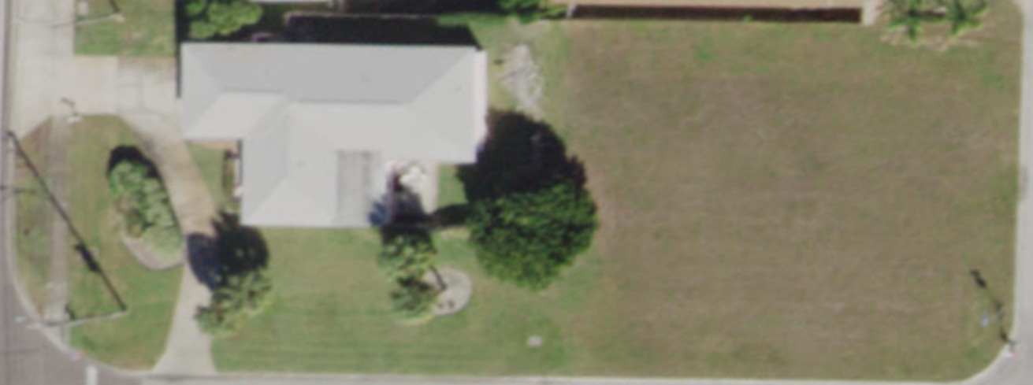
Stormwater Fee Basis
Industry Standard Basis
.7 Runoff Coefficient
.2 Runoff Coefficient
Taxable Value
Flat Fee
Dwelling Units
Gross Area
Pervious Area
Impervious Area
Increasing Equity

Slide 13
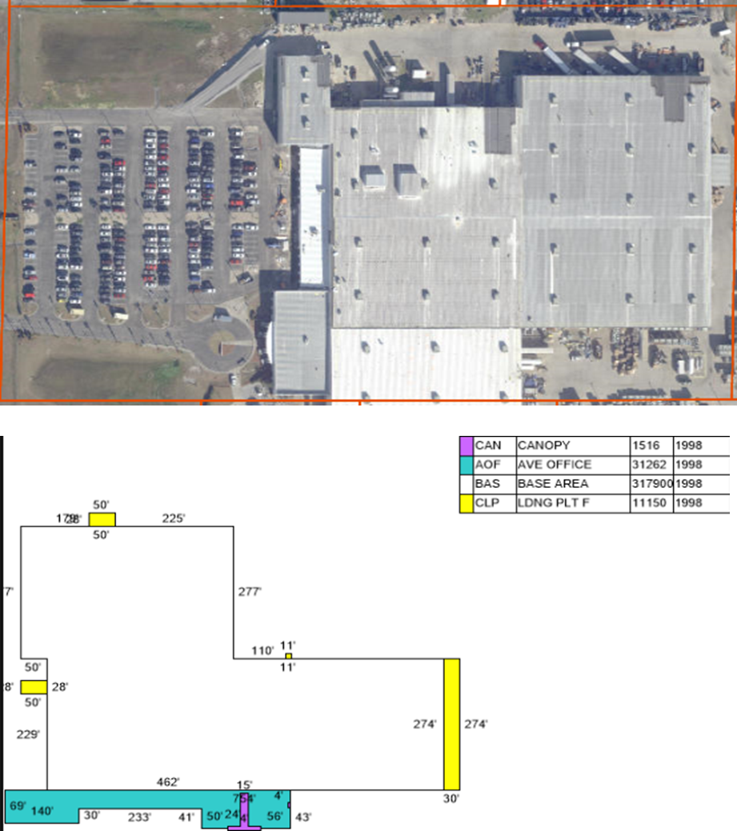

Billing Units Measurement
33 Million sq. ft. of impervious area

Slide 14

Fee Structure and Customer Impacts

Slide 15
Fee Structure Objectives
Revenue Requirement
Simplicity
Proportionality
Affordability

Slide 16
Fee Structure Options
The same average fee applies to all customers of a class.
Flat
Tiered
Like customers are grouped and several unique fees are applied.
Measured
Customers are considered unique and fees are individualized based on Equivalent Billing Unit.

Slide 17
Single Family

Slide 18
Single Family

Slide 19
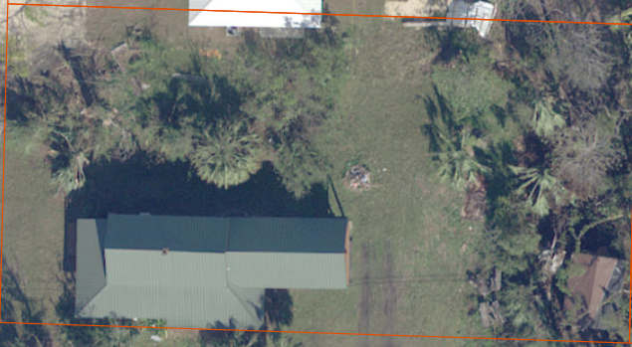
Single Family (Tier 1) Customer Impacts
 | Bill Comparison
Current Annual Fee | $42.48
Calculated Annual Fee | $71.29
$ Difference | $28.81
% Difference | 67.8%

Slide 20
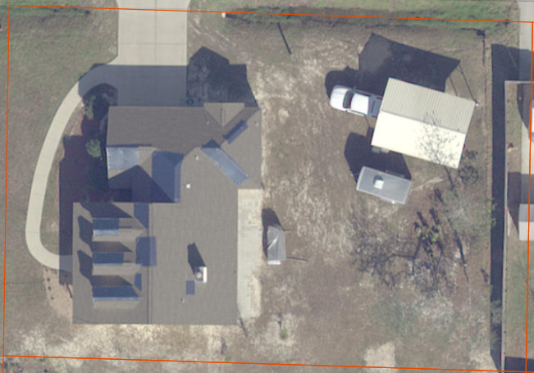
Single Family (Tier 2) Customer Impacts
 | Bill Comparison
Current Annual Fee | $42.48
Calculated Annual Fee | $139.78
$ Difference | $97.30
% Difference | 129.0%

Slide 21
Non-Single Family
Measured

Slide 22
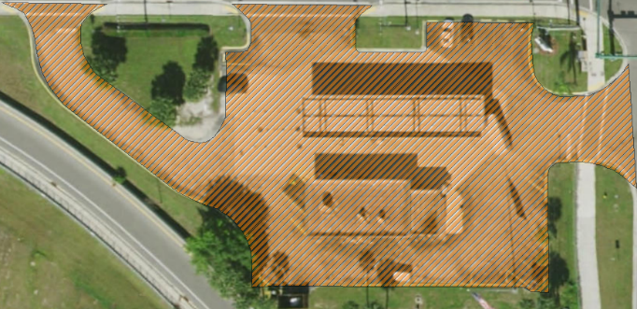
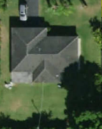
Measured Fee Structure for Non-Single Family
Non-Single Family Parcel
Equivalent Billing Units
Non-Single Family Parcel
(10 EBUs)
Equivalent Residential Units
(10 ERUs)
16,000 Sq. Ft. Impervious
Impervious area measured as Equivalent Billing Units (EBUs) is typically used as a basis for determining stormwater fees.

Slide 23
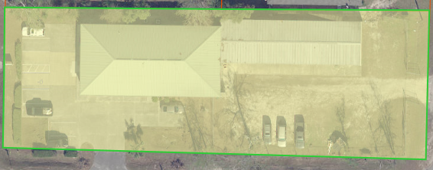
Non-Single Family Customer Impacts
 | Bill Comparison
Impervious Area (sq. ft.) | 8,065
Number of EBUs | (8,065 sq. ft./ 3,900 EBU) = 2.07
Current Annual Fee | $106.56
Calculated Annual Fee | $289.34
$ Difference | $182.78
% Difference | 71.5%

Slide 24
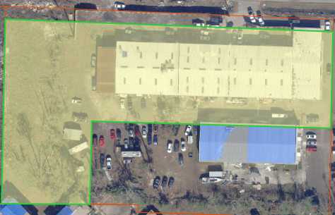
Non-Single Family Customer Impacts
 | Bill Comparison
Impervious Area (sq. ft.) | 36,420
Number of EBUs | (36,420 sq. ft. / 3,900 EBU) = 9.33
Current Annual Fee | $106.56
Calculated Annual Fee | $1,304.15
$ Difference | $1,197.59
% Difference | 1,124.0%

Slide 25
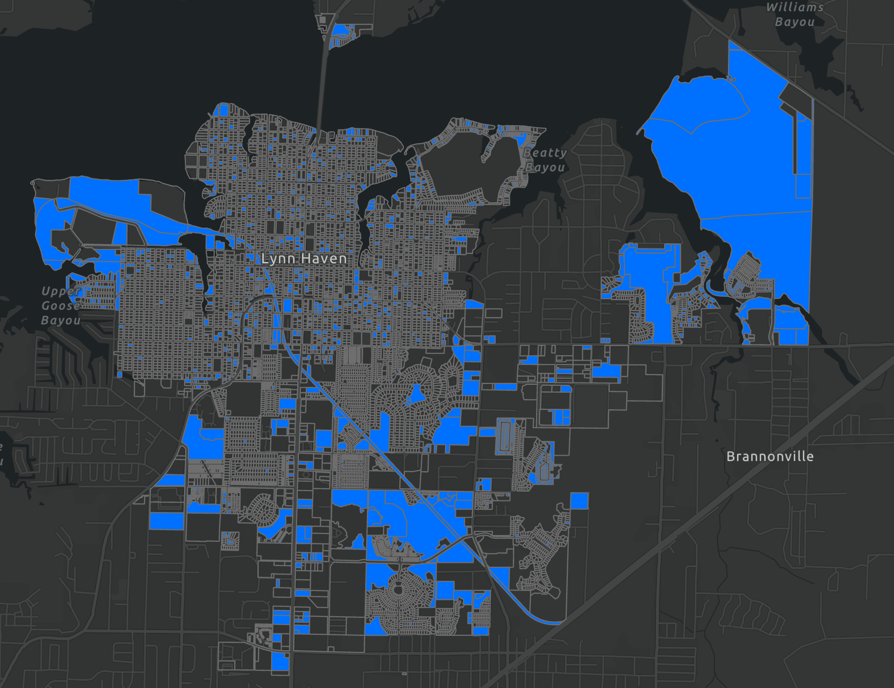
Vacant
Measured Gross Area
Capped at 5 Acres
1 sq. ft. of gross area = .29 Impervious area
Notes:
Capped at 5 acres $2,200

Slide 26
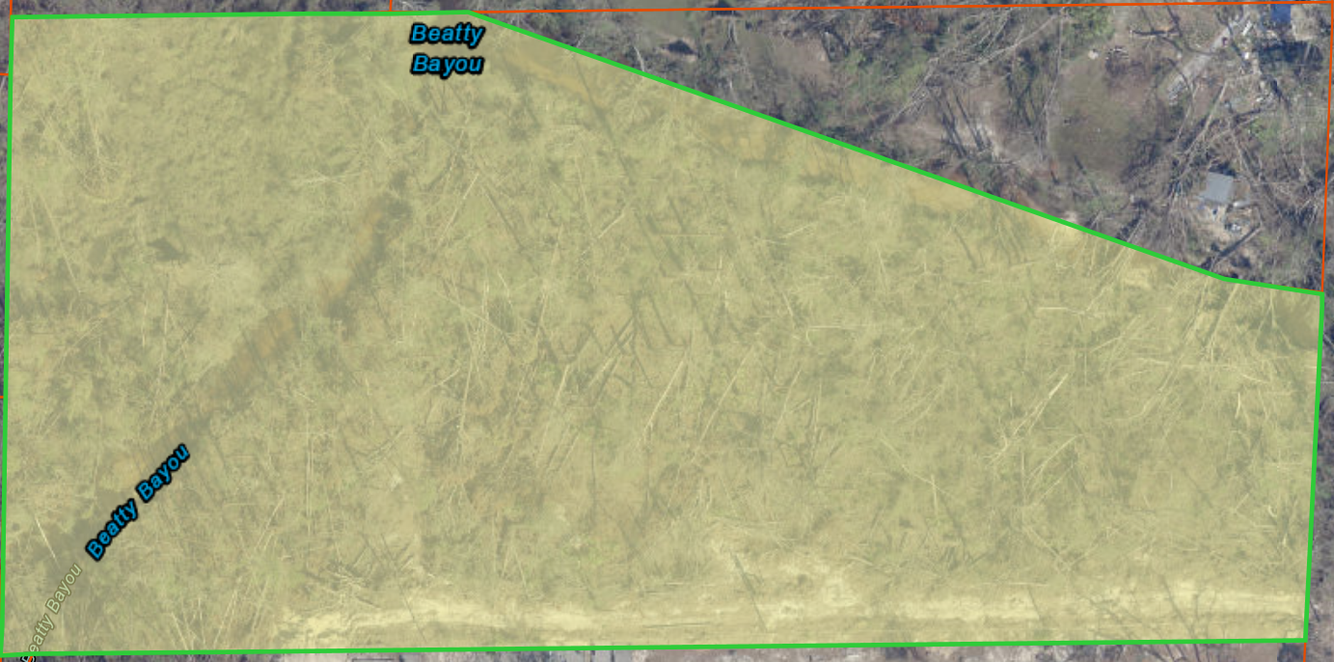
Vacant Customer Impacts
 | Bill Comparison
Gross Area (sq. ft.) | 174,240
Number of EBUs | (174,240 sq. ft./ 3,900 EBU) = 44.67
Current Annual Fee | $0
Calculated Annual Fee | $1,811.00
$ Difference | $1,811.00

Slide 27
Stormwater Fee Summary
Fee Type | FY 2022 | FY 2023 | FY 2024 | FY 2025 | FY 2026
Vacant Fee (Per 3,900 sq. fts of vacant) | $40.54 | $60.81 | $85.13 | $87.68 | $90.31
Non-Single Family Fee (Per 3,900 sq. ft. of Impervious) | $139.78 | $209.67 | $293.54 | $302.35 | $311.42
Single Family Tier 1 (400 – 2,900 sq. ft.) | $71.29 | $106.94 | $149.72 | $154.21 | $158.84
Single Family Tier 2 (2,901 & Greater sq. ft.) | $139.78 | $209.67 | $293.54 | $302.35 | $311.42

Slide 28
Stormwater Fee Survey

Slide 29

Billing Methodology

Slide 30
Billing Methodology
Utility Billing – Current City Method
Non-Ad Valorem Assessment
Recommended
PRO
Easier to Change the Fee
Greater Accuracy and More Equitable
High Collection Rate
Lower Staff Administration
Updated With Tax Roll
Property Owner vs. Renter Paying
Difficult to Manage and Update
Strict Timeline
CON
Collection Issues / Write-off
Public Notice
Nonactive Utility Customers Are Not Billed/Paying Fee
Tax Collector Cost
Reduced Revenue and Subsidized by Others

Slide 31
Non-Ad Valorem Timeline
By June 1 – property appraiser provide City with list of names and addresses of property owners. F.S. 197.3632 (3)(b)
Between January 1 and September 15 - Public hearing to adopt non-ad valorem assessment roll F.S. 197.3632 (4)(a)
  20 days prior to public hearing - Noticing for the Public Hearing to adopt non-ad valorem assessment including first-class mail to all parcel owners and publication in newspaper F.S. 197.3632 (4)(b)
By September 15 - Certification of a non-ad valorem assessment roll to tax collector F.S. 197.3632 (5)(a)
By December 15 - Tax collector shall provide non-ad valorem assessment roll to City F.S. 197.3632 (5)(b)

Slide 32

Impact Fee

Slide 33
Updated Impact Fees

Slide 34
Impact Fee Recommendations
Consider updating stormwater impact fees to match investment cost
Consider a flat fee for all single-family homes
Monies should only be used for growth related capital
Fees should be updated every 5-7 years to account for changes

Slide 35


Findings
Property Appraiser data used for impervious area fee basis and should be updated annually.
Fee structure change increases equity with residential tiers and # EBUs for non-single family
Billing methodology change from utility bill to non-ad valorem assessment beginning October 1, 2021
Stormwater fee increase is needed in FY22 to meet current revenue needs.
Impact Fee updated based on invested system

Slide 36
Next Steps
July 23
Finalize Assessment Roll and Notice Letters
July 27
Public Outreach Meeting
August 2
Mail Notice Letters
August 10
Commission Initial Resolution and Proposed Assessment Roll
August 24
Public Hearing for Final Resolution and Adopt Assessment Roll
October 1
New Rates Effective

Slide 37

Questions/Comments
?
Project Team:
Kelly Westover
Project Manager
Kyle Stevens
Primary Consultant
Chris Forehand
Panhandle Engineering

