Slide 1
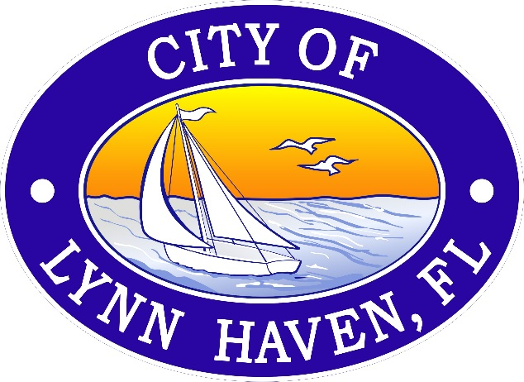
City of Lynn Haven
Budget Workshop
September 22, 2014
Joel B. Schubert,
City Manager

Slide 2

Overall Goals
Six Strategic Initiatives:
Budget: Self-sufficient General Fund, build reserves
Maintain and improve infrastructure
Capitalize use of and ensure condition of City-owned property
Improve and attract economic development
Maximize human capital
Enhanced communication plan
Notes:
1. Balance budget means no spending cash (reserves) and the general funds is self-sufficient.

Slide 3
Overall Goals
Enterprise Fund:
Reserve enterprise revenue for enterprise capital projects (infrastructure).
Revenue:
Ensure fair and appropriate rates
  Study when necessary, CPI adjustments
  New fees
Leverage grants
Expenditures:
Leverage City staff for all projects when appropriate
Intergovernmental agreements

Slide 4
Overall Goals
General Fund:
Self-sufficiency.
Expenditures:
Leverage City staff for all projects when appropriate
Cross training of staff
Intergovernmental agreements
Revenue:
Half-cent sales tax
Leverage grants
Ad-valorem rate
New Fees

Slide 5
Ten-year History: Comparison of City of Lynn Haven Employees by Department
FUNDED POSITIONS | 05/06 | 14/15 | Difference
Executive | 4 | 3 | -1
Admin | 4 | 4 | 0
Planning | 3 | 2 | -1
PW Admin | 3 | 3 | 0
Police | 51 | 48 | -3
Fire | 23 | 22 | -1
Building | 5 | 4 | -1
Street | 7 | 4 | -3
Fleet Mgmt. | 3 | 3 | 0
Library | 5 | 4 | -1
Leisure Services | 20 | 19 | -1
Water | 16 | 16 | 0
Sewer | 10 | 9 | -1
Storm Water | 7 | 6 | -1
Sanitation | 12 | 12 | 0
CRA/Main Street | 0 | 1 | 1
# Employees | 173 | 159 | -14

Slide 6
Comparison of Employee per Citizen Ratio*
*part-time employees not included

Slide 7
Ten-year History: Population vs. # of City of Lynn Haven Employees

Slide 8
Nine-year History: Tax Base, Ad Valorem Proceeds and Millage Rate

Slide 9
Nine-year History: Tax Base, Ad Valorem Proceeds and Millage Rate

Slide 10
Comparison of Millage Rates
Millage Rate
3.87
N/A
3.75
5.77
5.82
Avg: 4.80

Slide 11
Summary
Facts:
Similar sized cities that provide similar services average 1 employee per 76 citizens, Lynn Haven’s average is 1 employee per 124 citizens
Similar sized cities that provide similar services average a millage rate of 4.80
Over the past ten years:
The City’s population has grown by 3,000
The City’s staff has been reduced by 14
While the quantity of services has increased the quality has remained the same
The proceeds from ad-valorem are effectively the same, (increase of $84,319)
Notes:
1. Balance budget means no spending cash (reserves) and the general funds is self-sufficient.

Slide 12
Thank you

